Slide 1
JSP and Servlet

Slide 2

Developing Web Applications and Web Services using Java

Slide 3
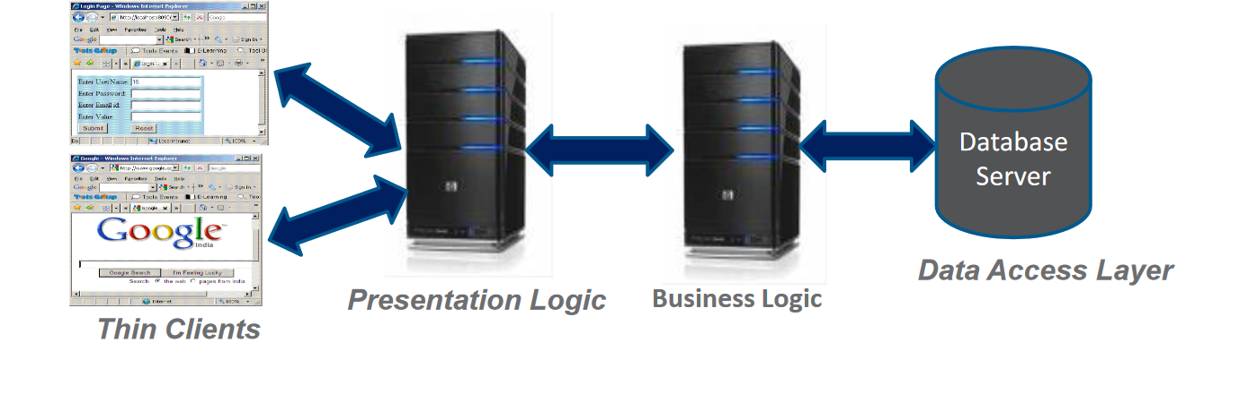
Typicallyithasn-tierarchitecture
N-Tier Enterprise Applications

Slide 4
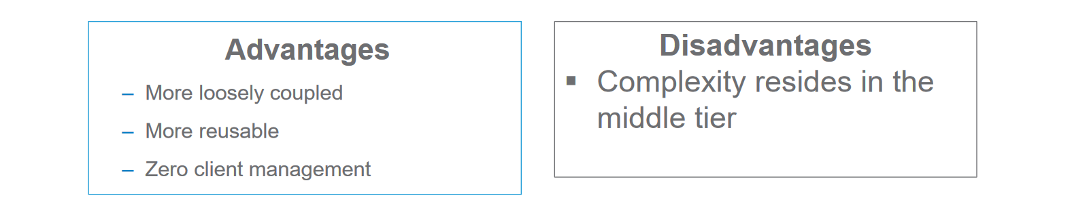
Examples of Enterprise Application
Oracle E-Biz suite

Slide 5
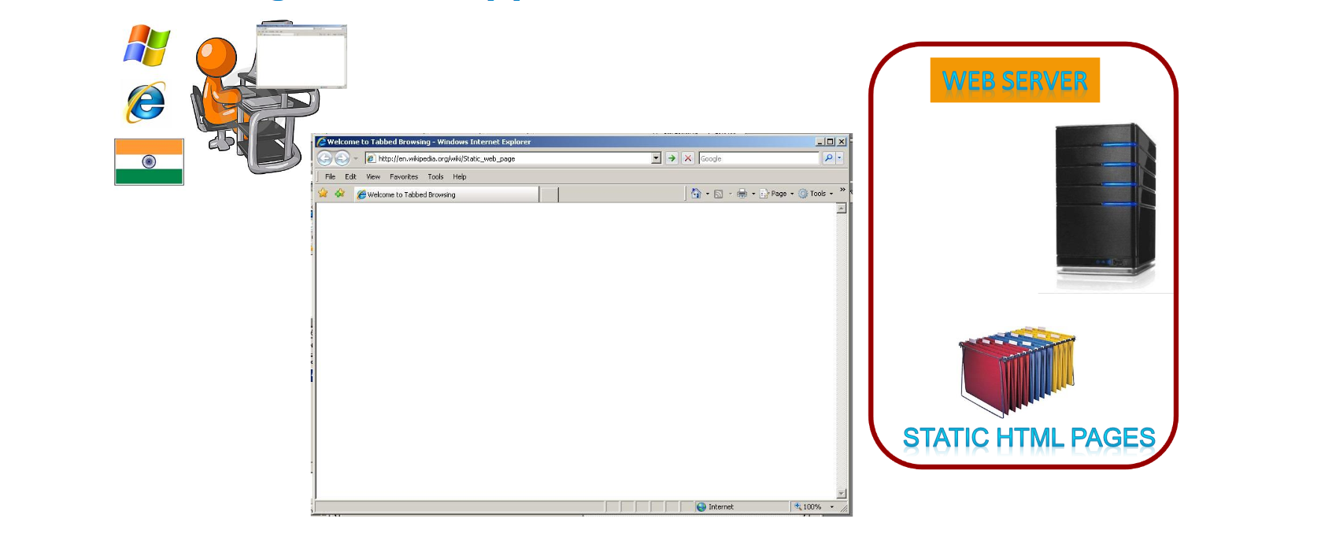
Working of Web Application: Static Content

Slide 6
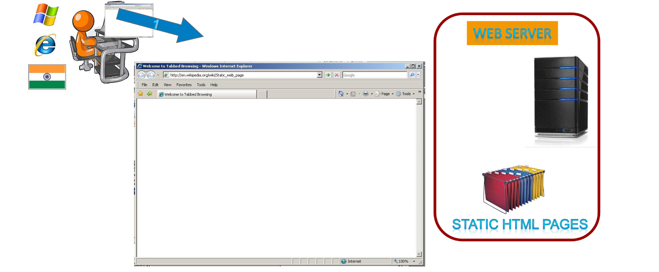

Slide 7
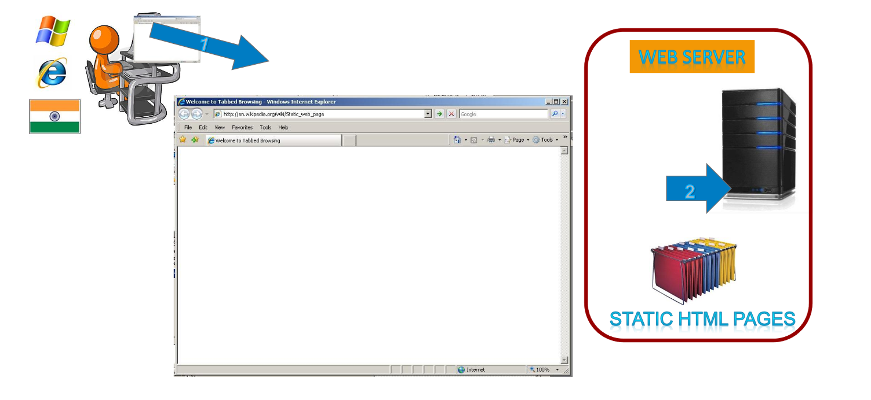

Slide 8
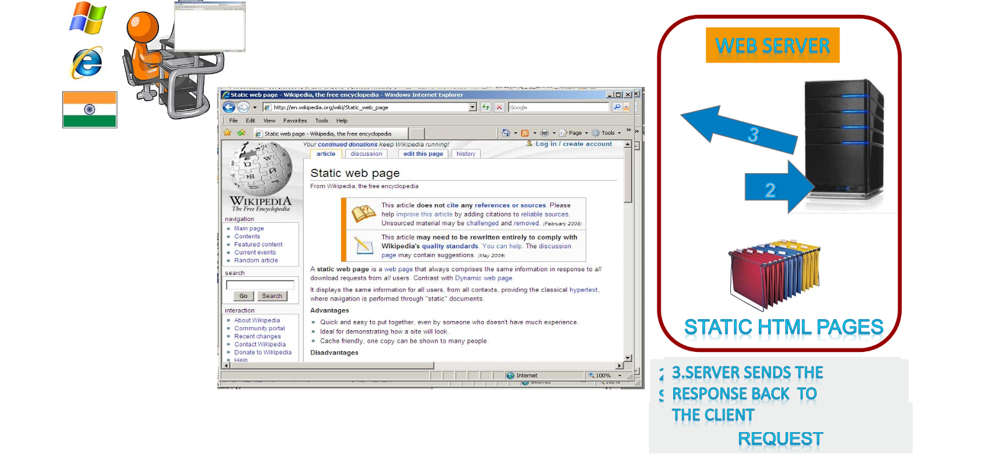

Slide 9
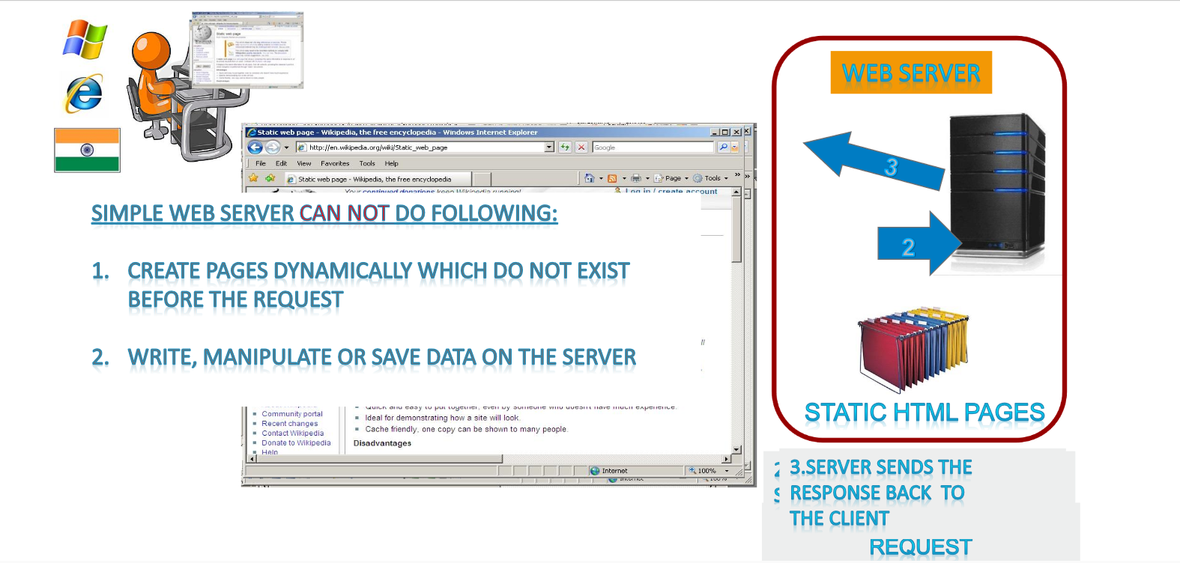

Slide 10
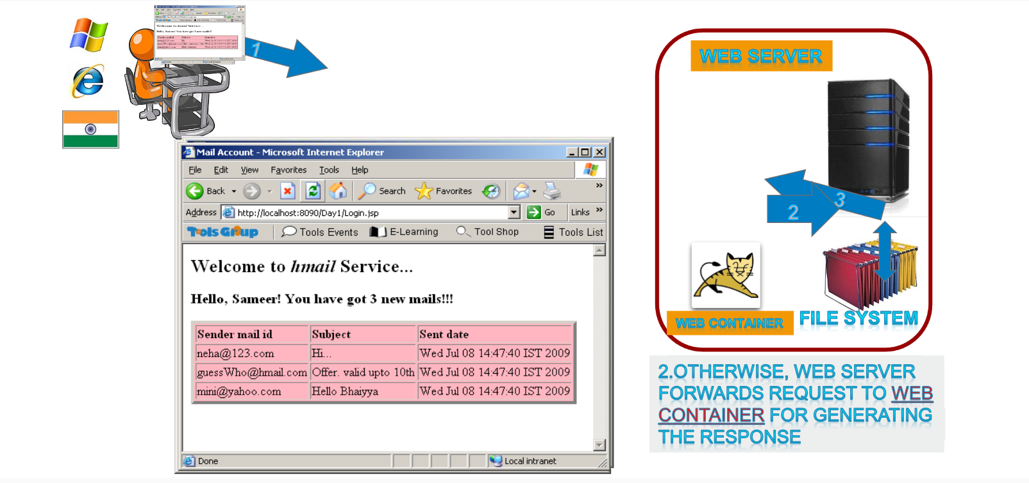
Generation of Dynamic Page

Slide 11
HTTP Protocol
Hyper Text Transfer Protocol or HTTP is the protocol used by the world wide web
According to the HTTP protocol, the client should send a Request to the server in a special format
Based on the Request, the server will send back a Response, which again is in a special format
HTTP Request
The following is the request generated by Internet Explorer when the URL washttp://www.yahoo.com

Slide 12
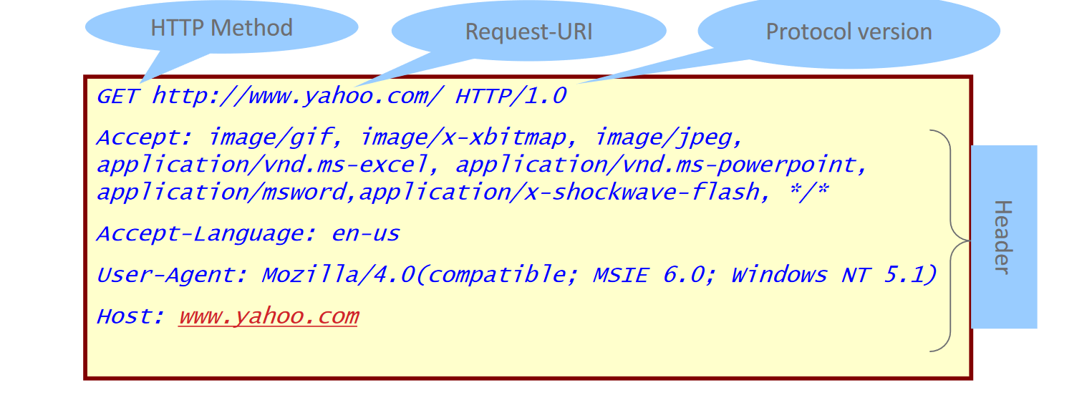

Slide 13
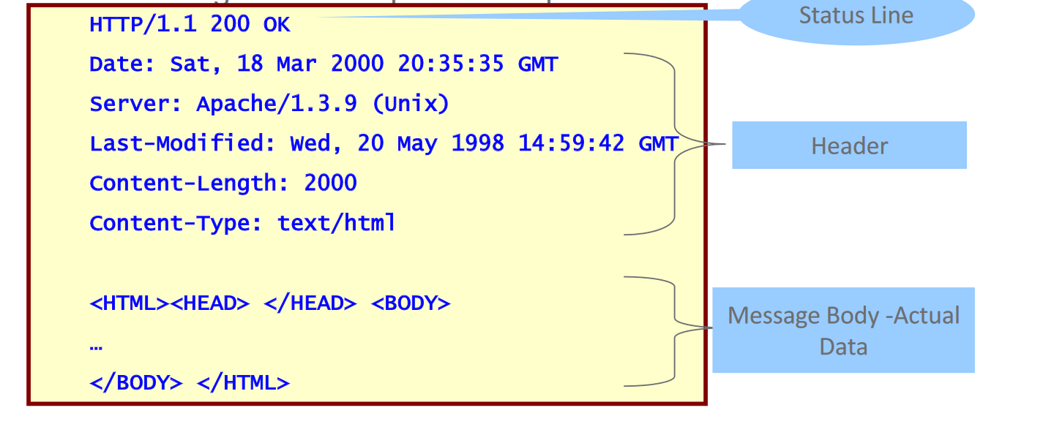
HTTP Response
The server processes the request and sends a response
The following is an example of a response

Slide 14
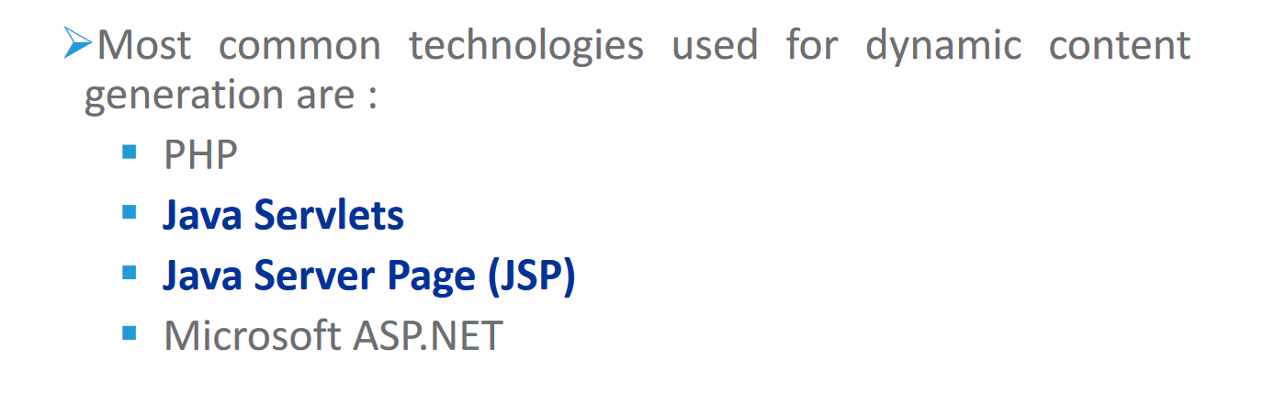
Technologies for dynamic content generation

Slide 15
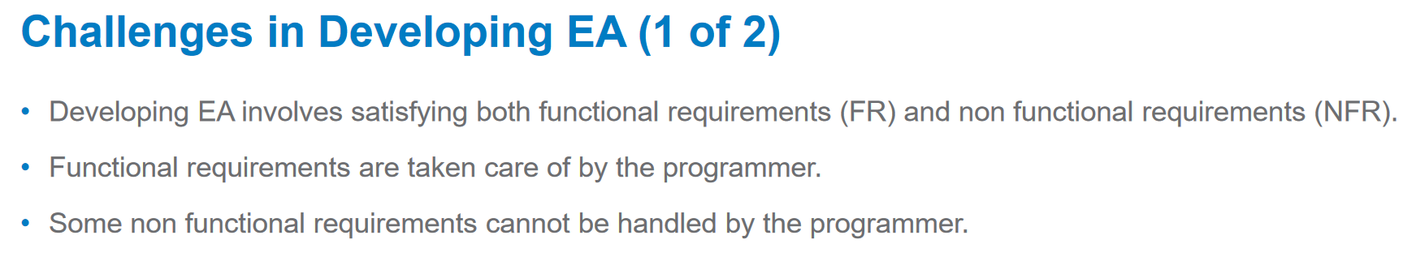

Slide 16
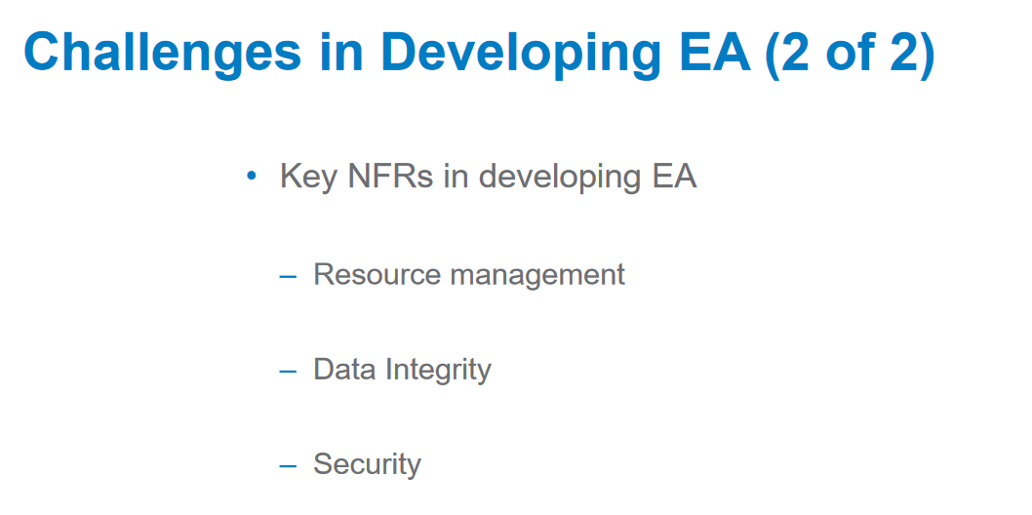

Slide 17
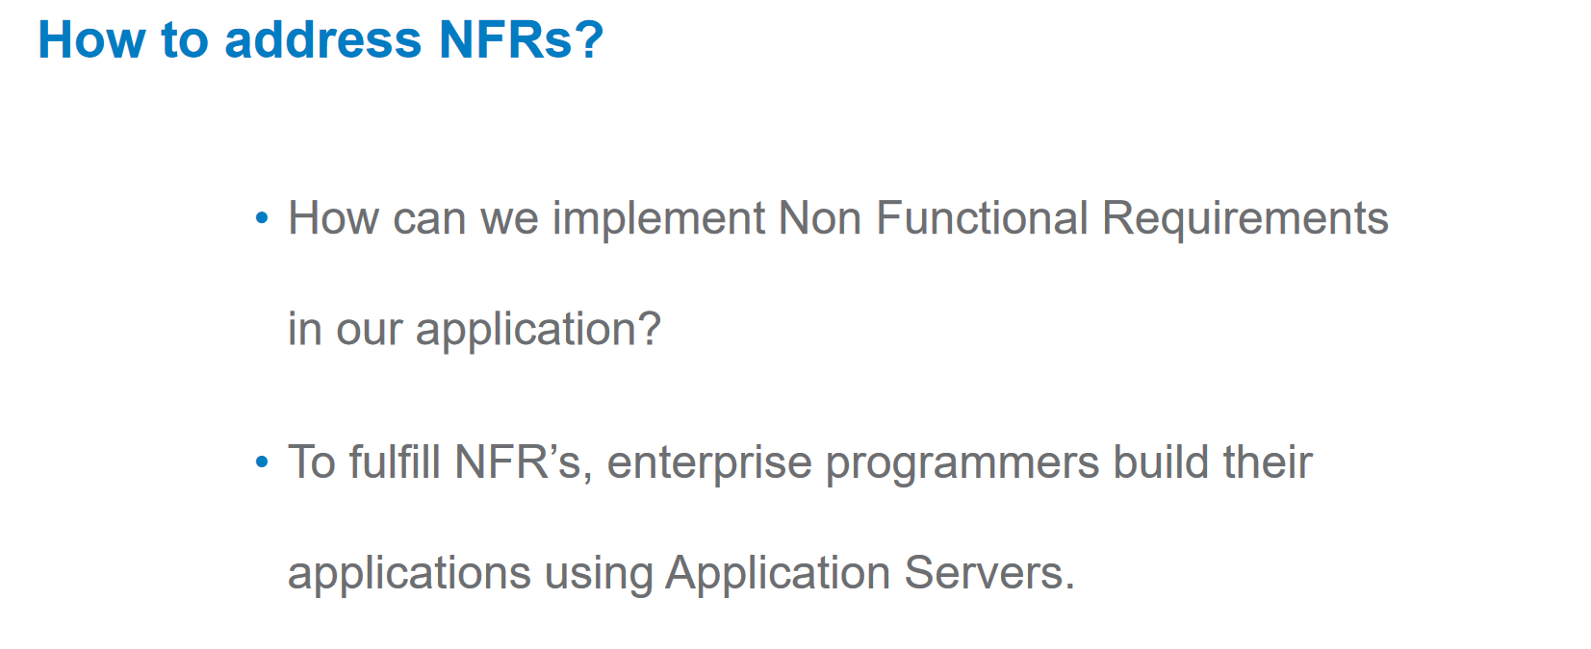

Slide 18
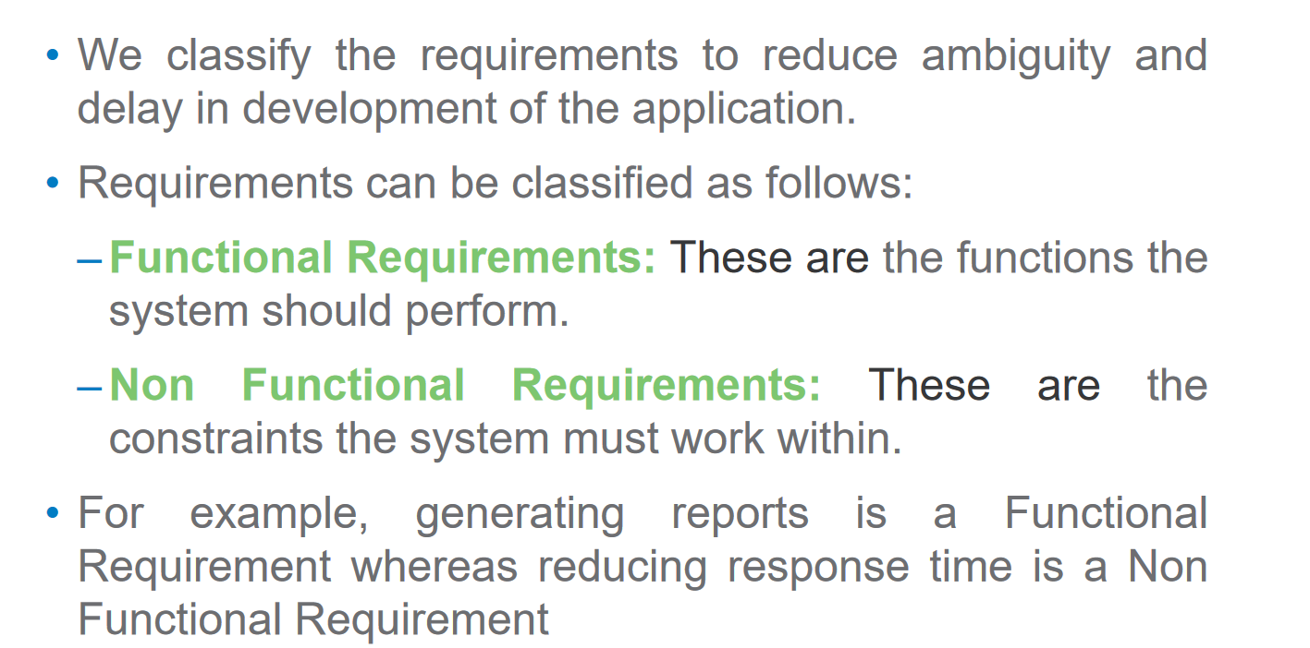
Classification of Requirements

Slide 19
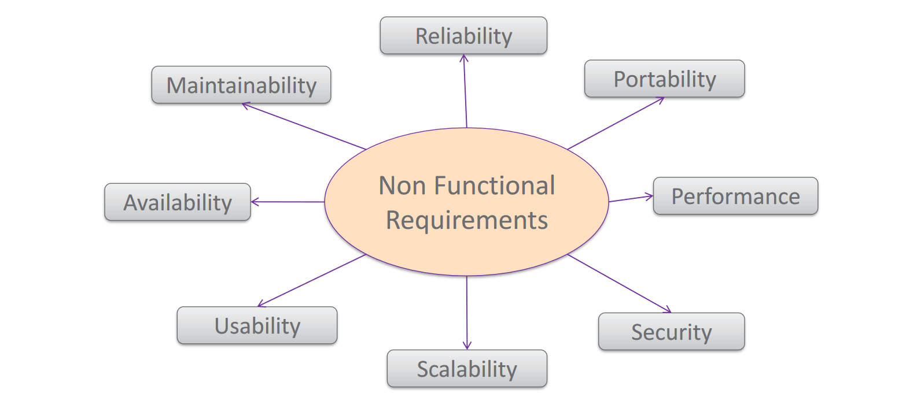
Non Functional Requirements

Slide 20
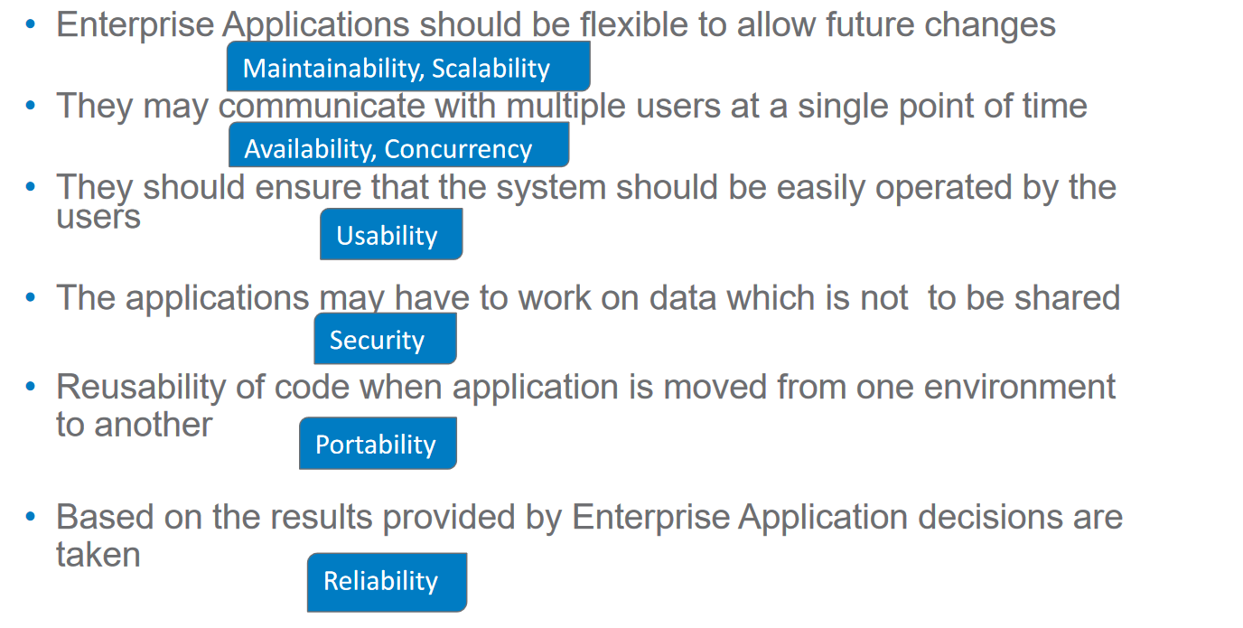
Need for identifying Non Functional Requirements in Enterprise Application

Slide 21
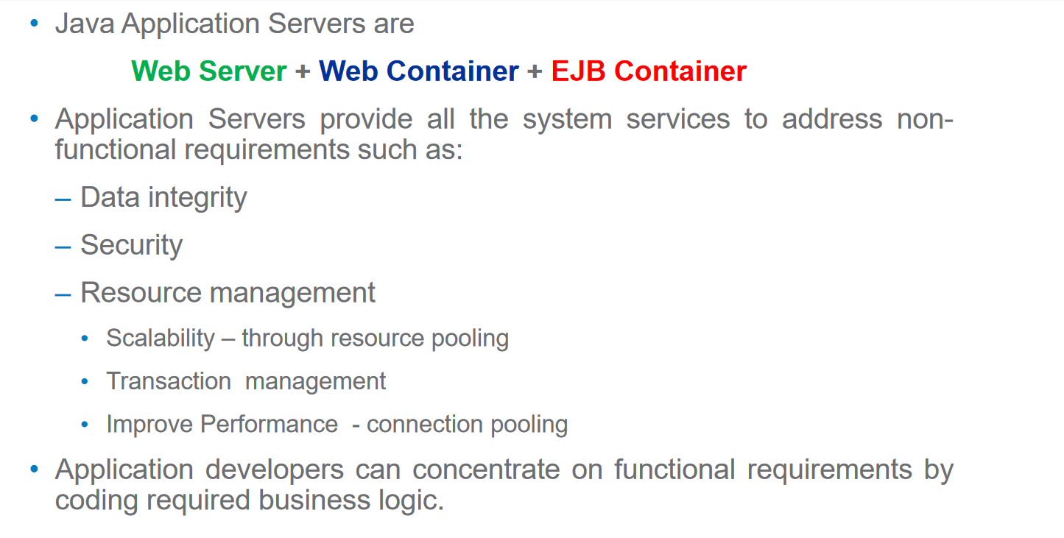
Application Server

Slide 22
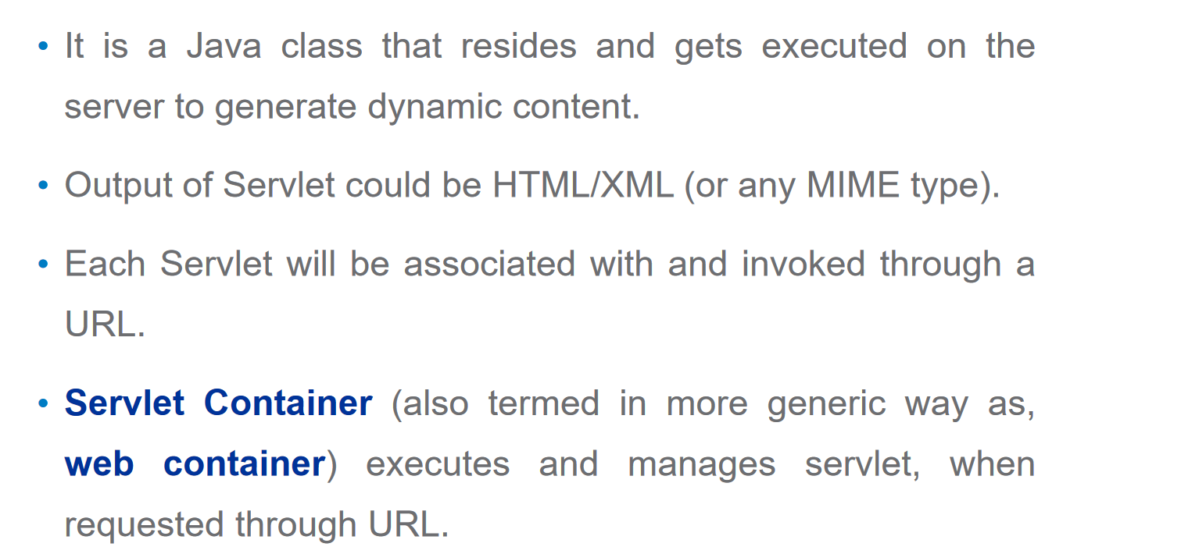
Servlets

Slide 23
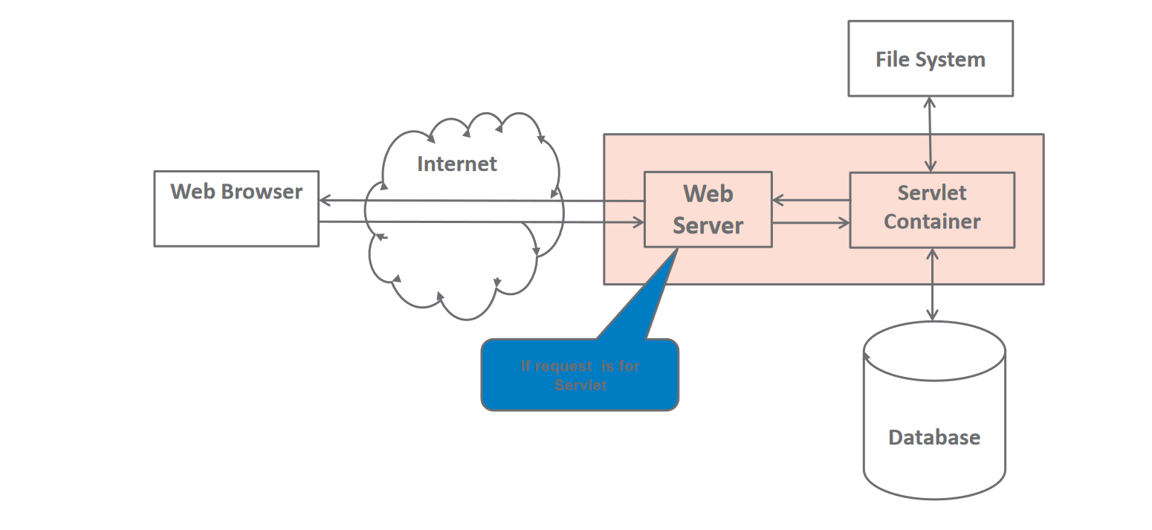

Slide 24
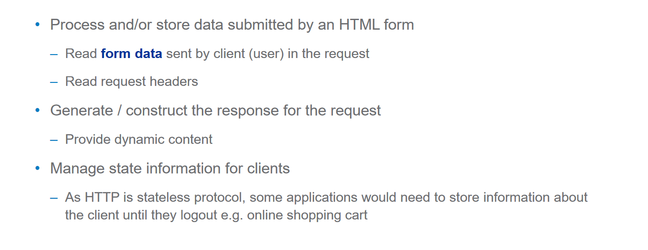
What a Servlet can do?

Slide 25
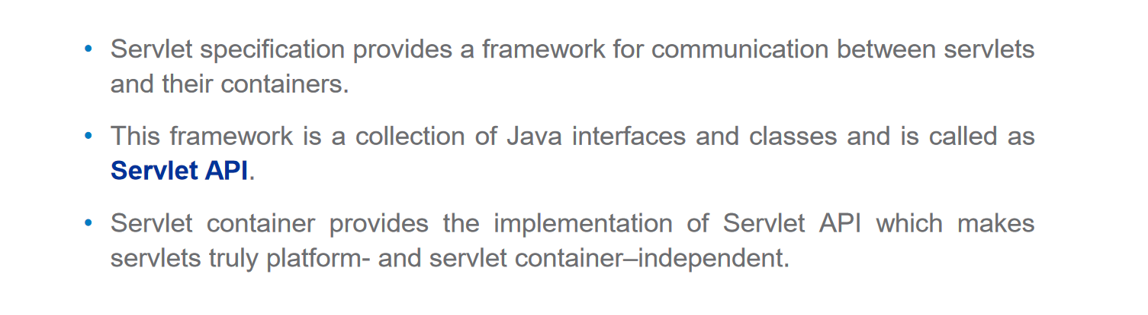
Servlet API

Slide 26
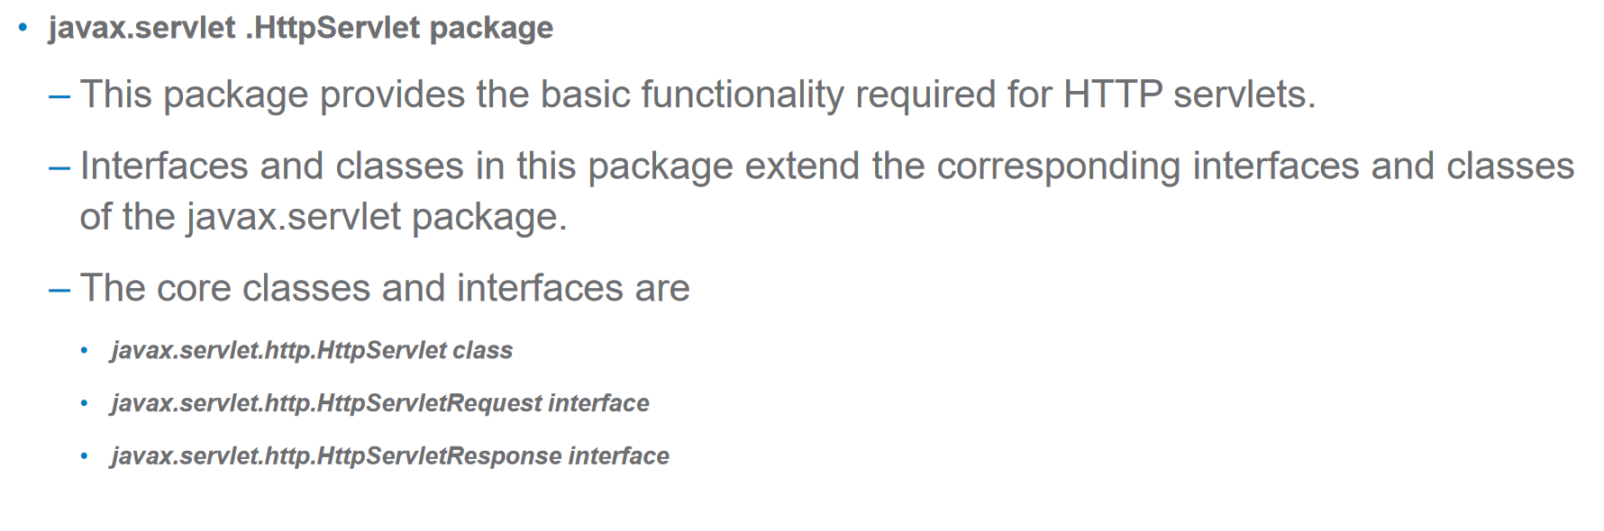

Slide 27
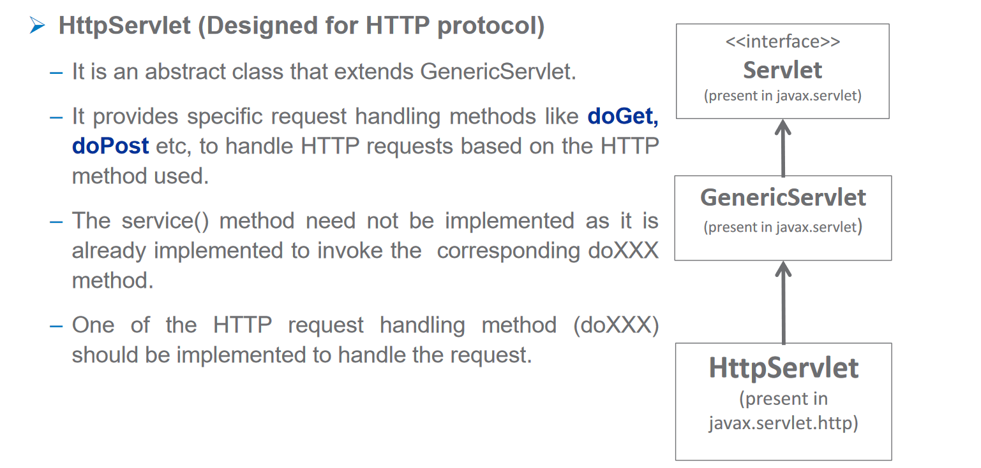
HttpServlet

Slide 28

Checking the http request and response using Mozilla or chrome and observing web.xml

Slide 29
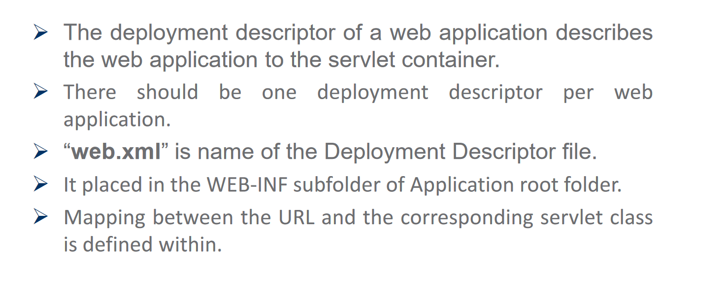
Deployment Descriptor

Slide 30
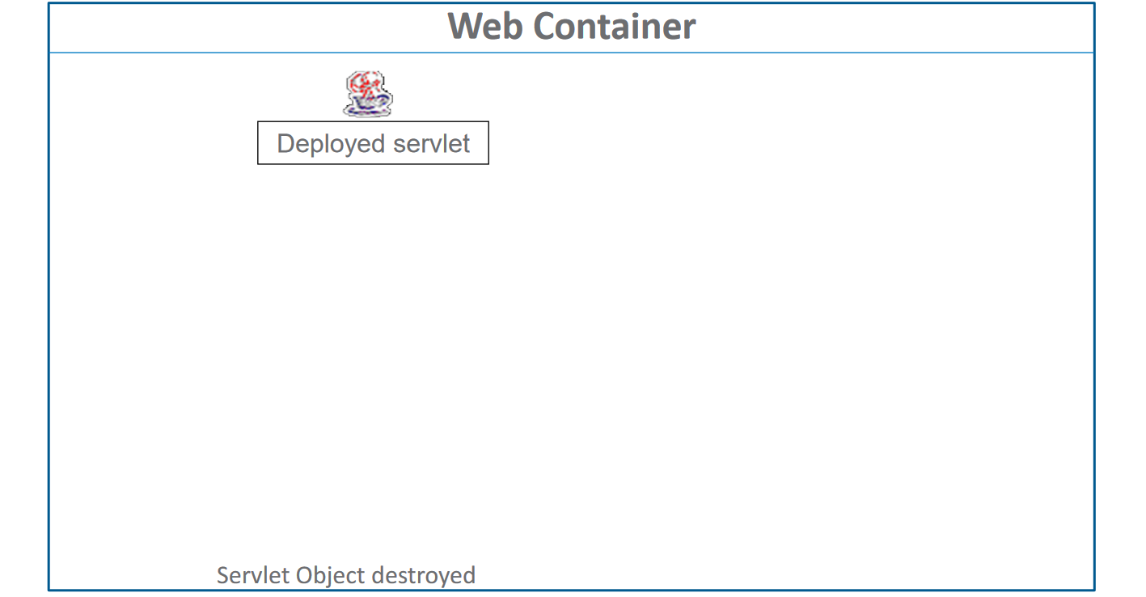
Servlet Life Cycle

Slide 31
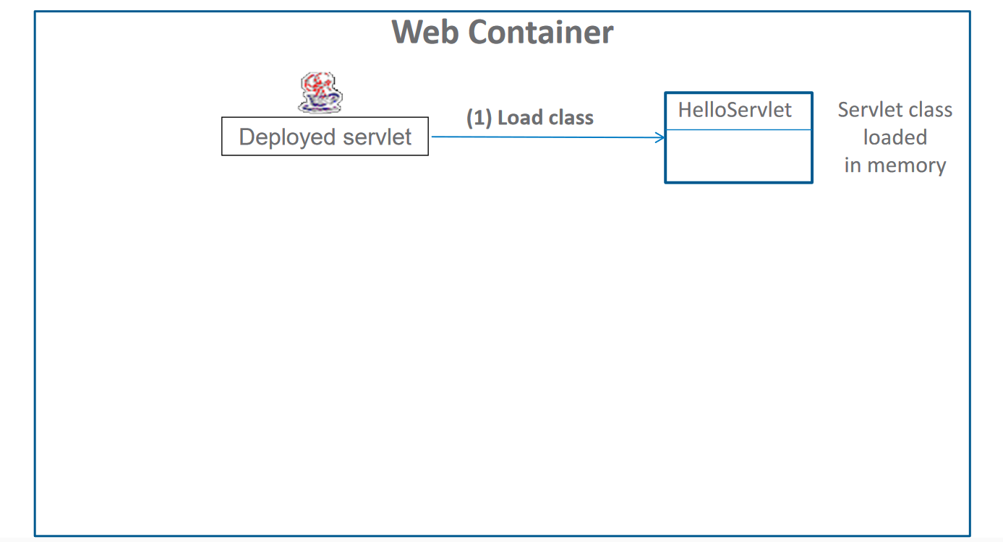

Slide 32
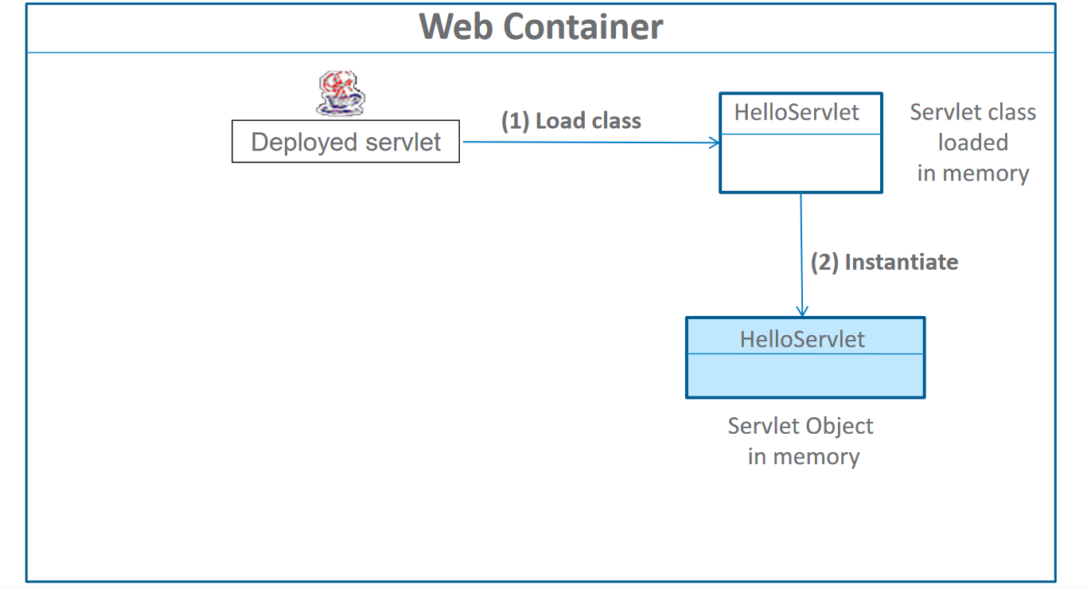

Slide 33
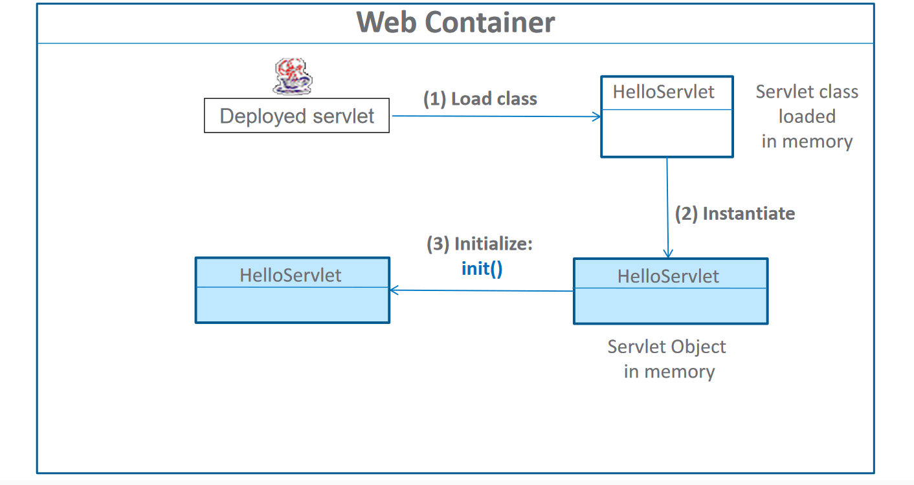

Slide 34
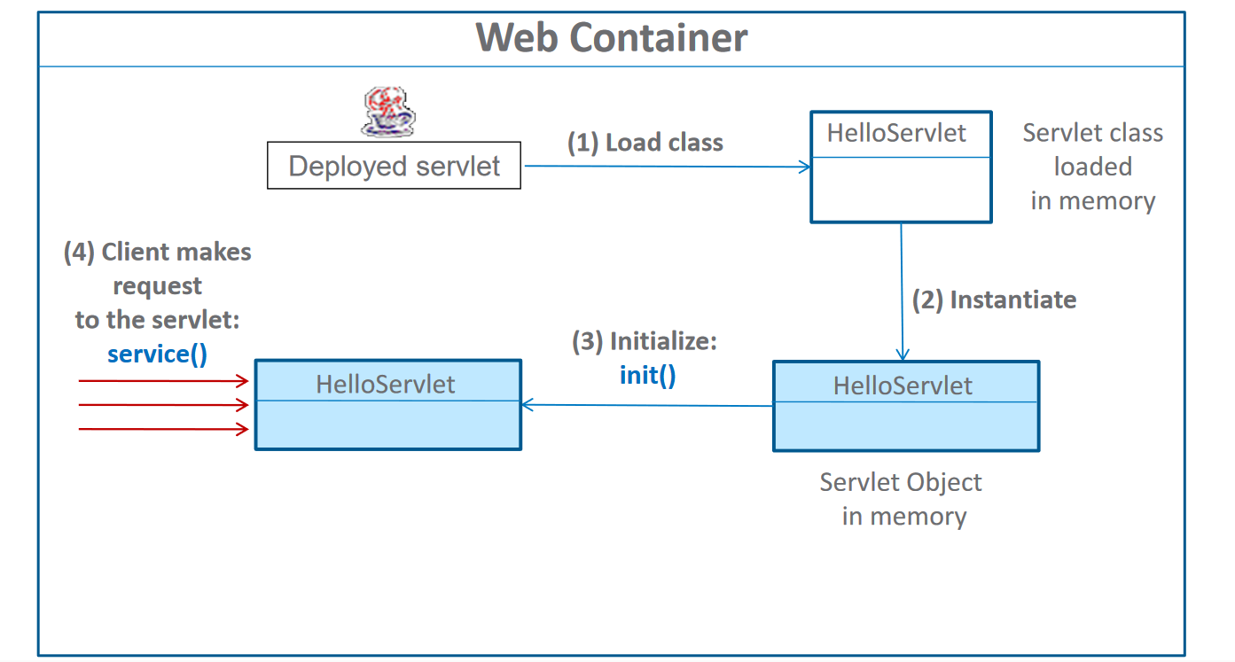

Slide 35
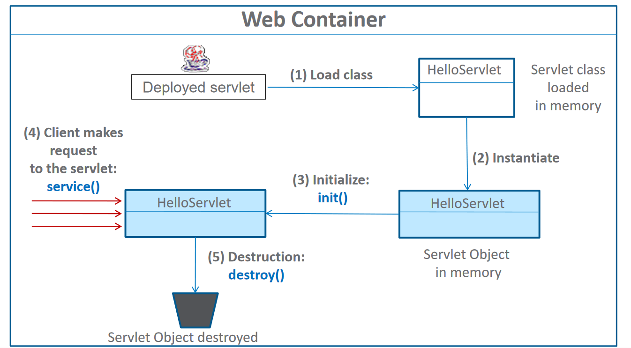

Slide 36
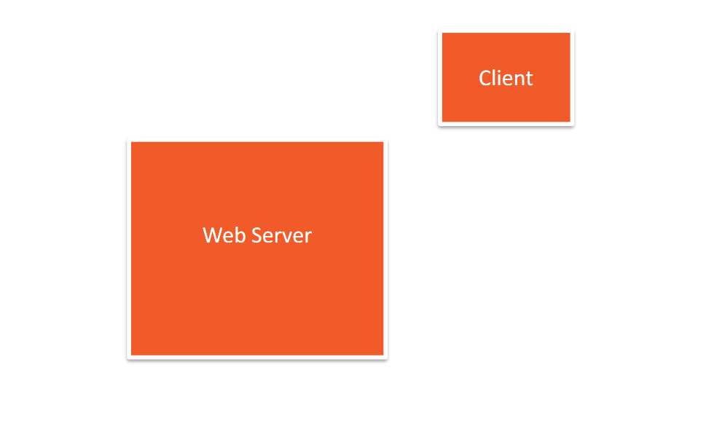
Servlet Lifecycle –New request

Slide 37
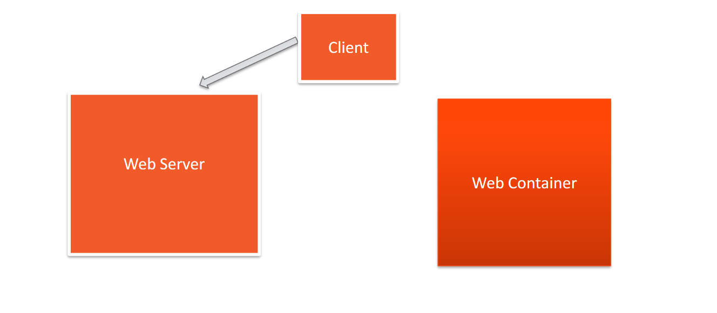

Slide 38
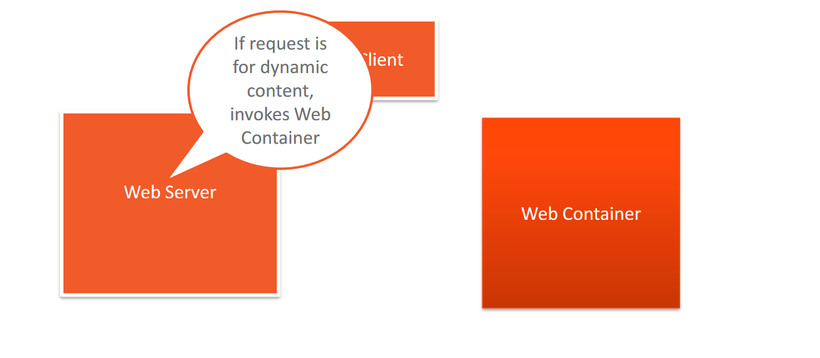

Slide 39
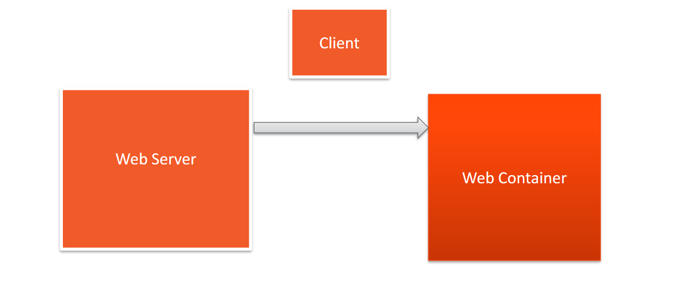

Slide 40
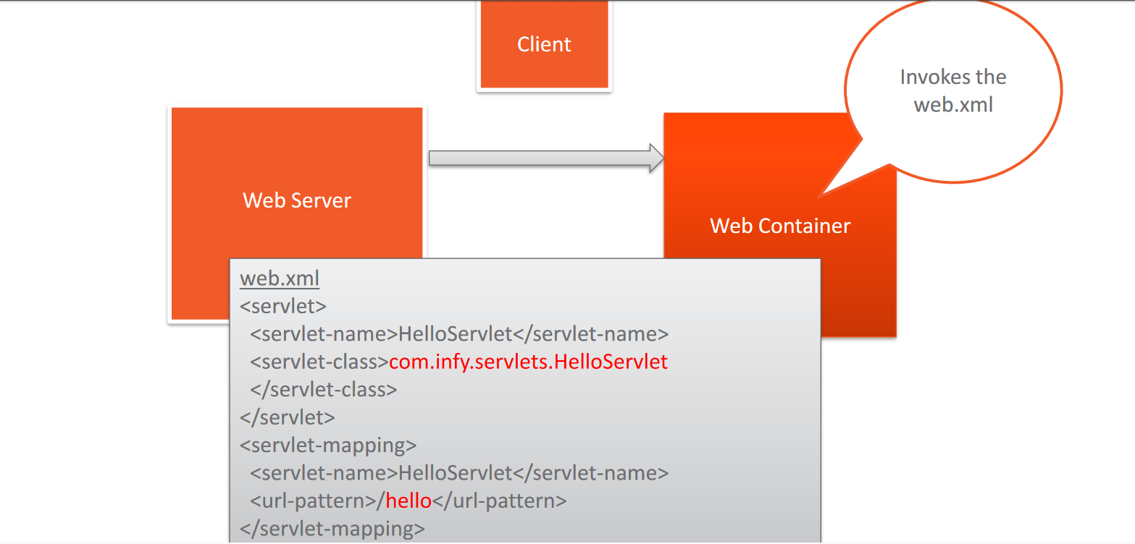

Slide 41
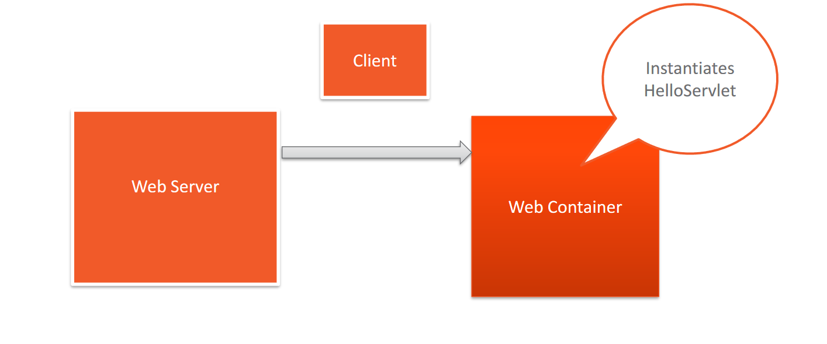

Slide 42
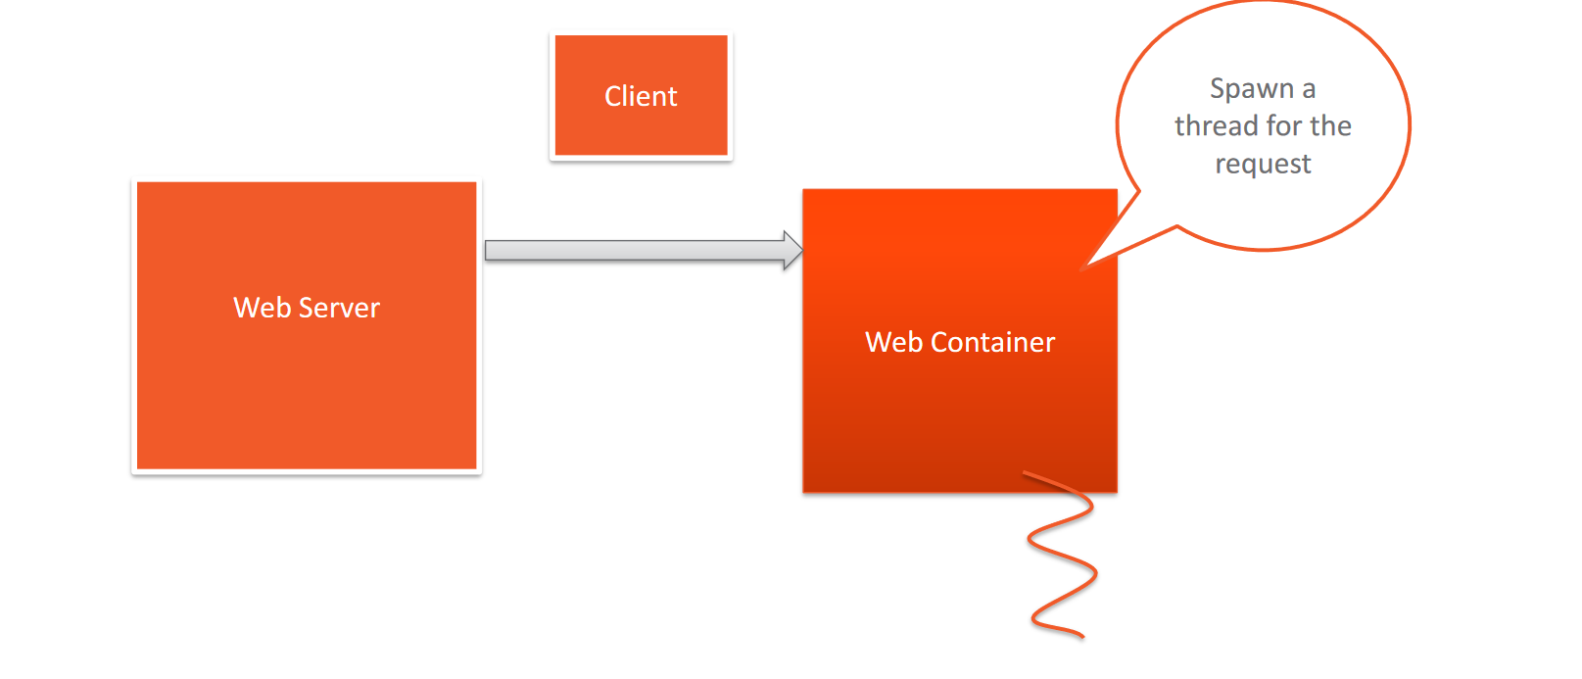

Slide 43
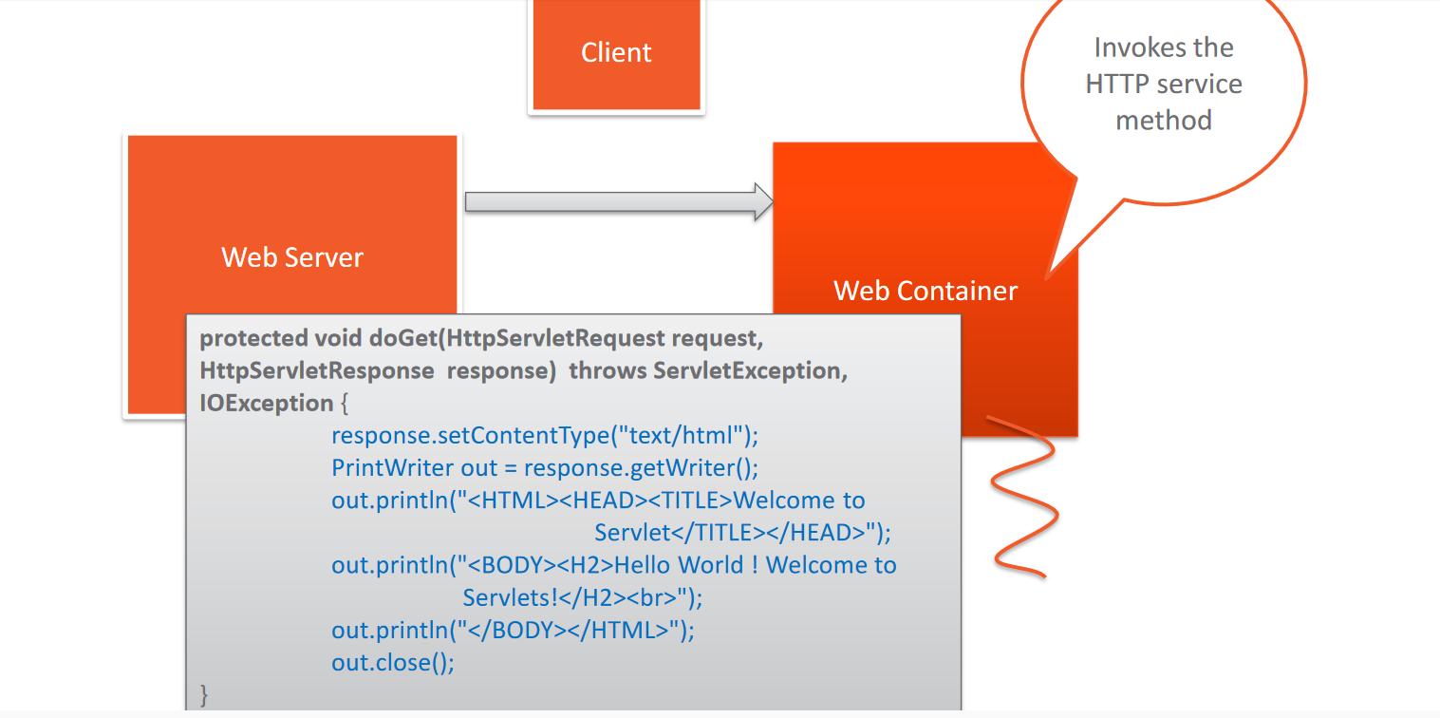

Slide 44
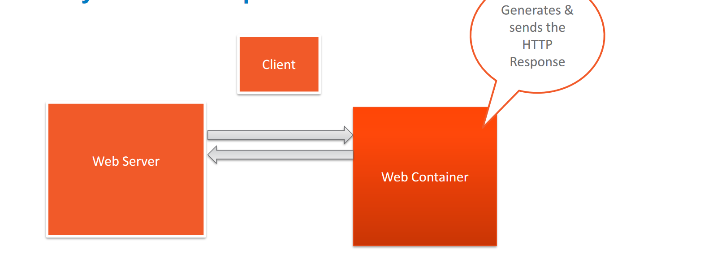

Slide 45
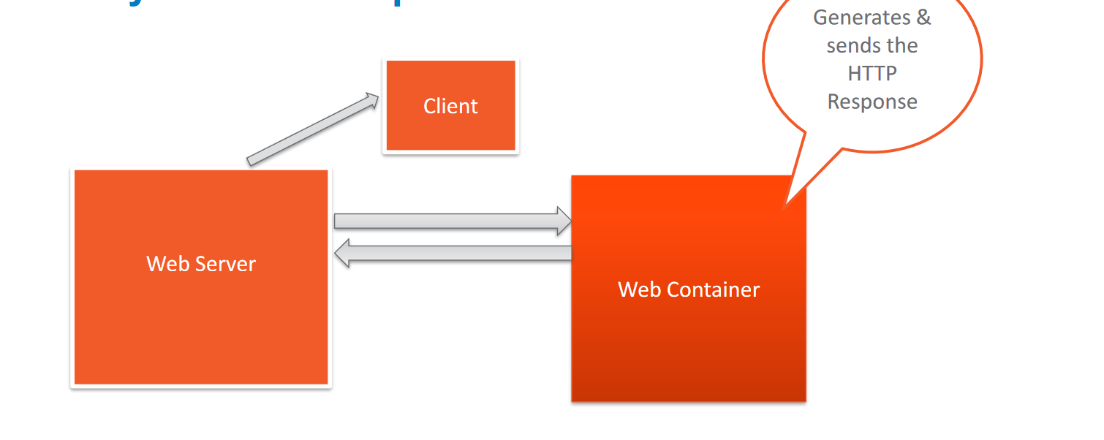

Slide 46
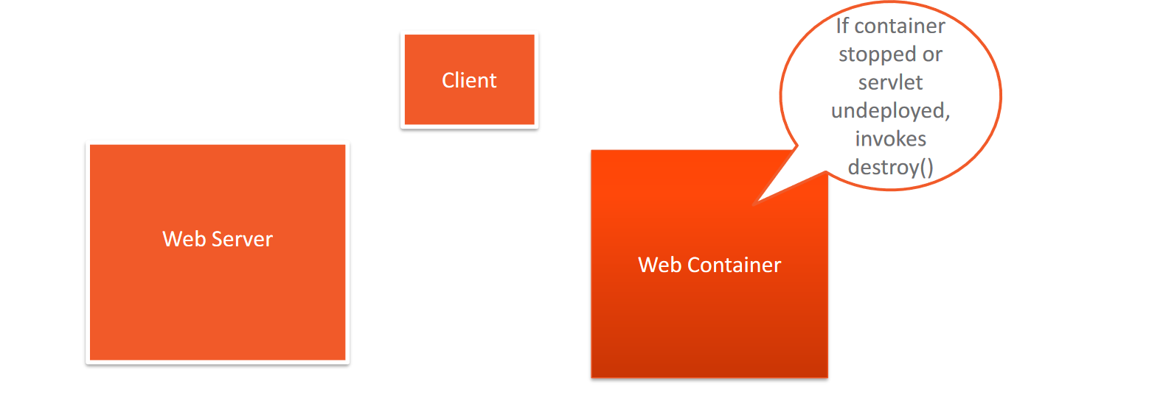

Slide 47
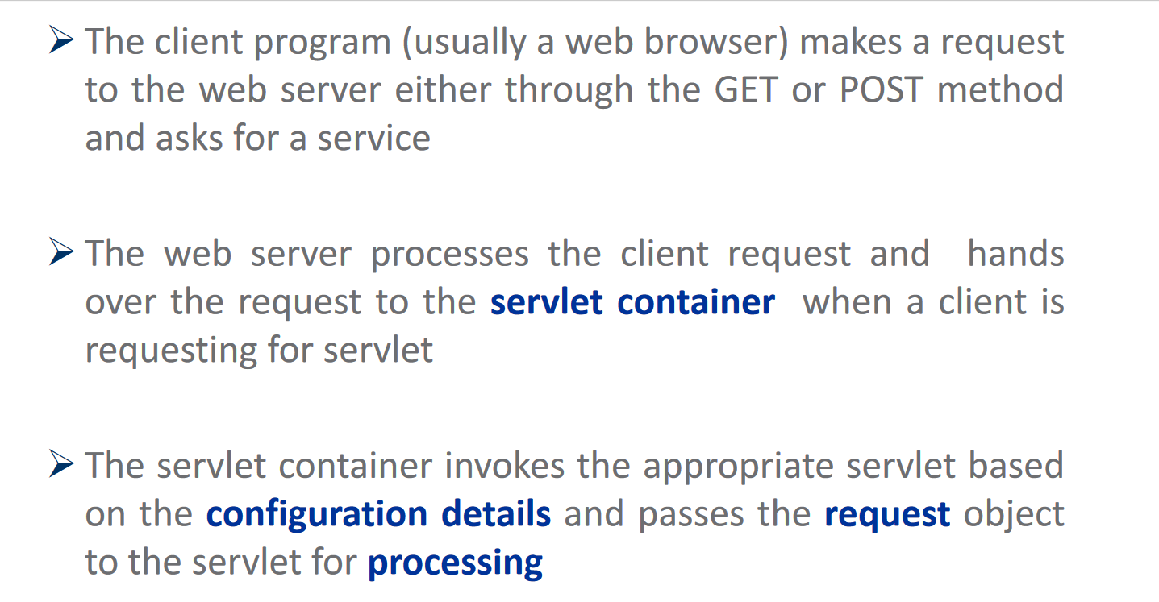
Servlets: the Request-Process-Response cycle (Self study)

Slide 48
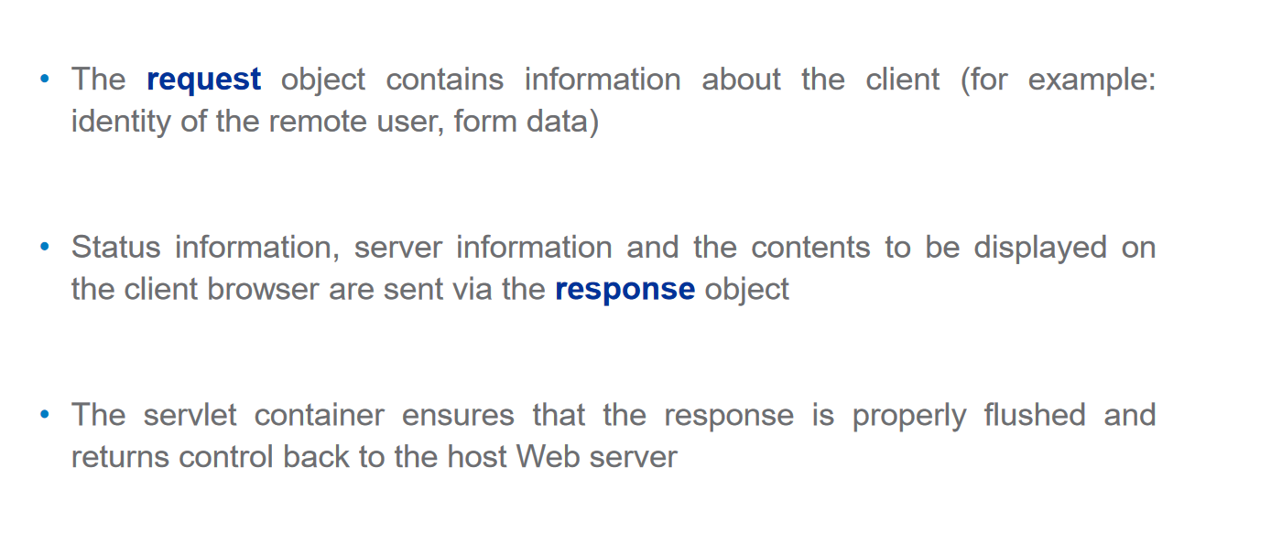

Slide 49
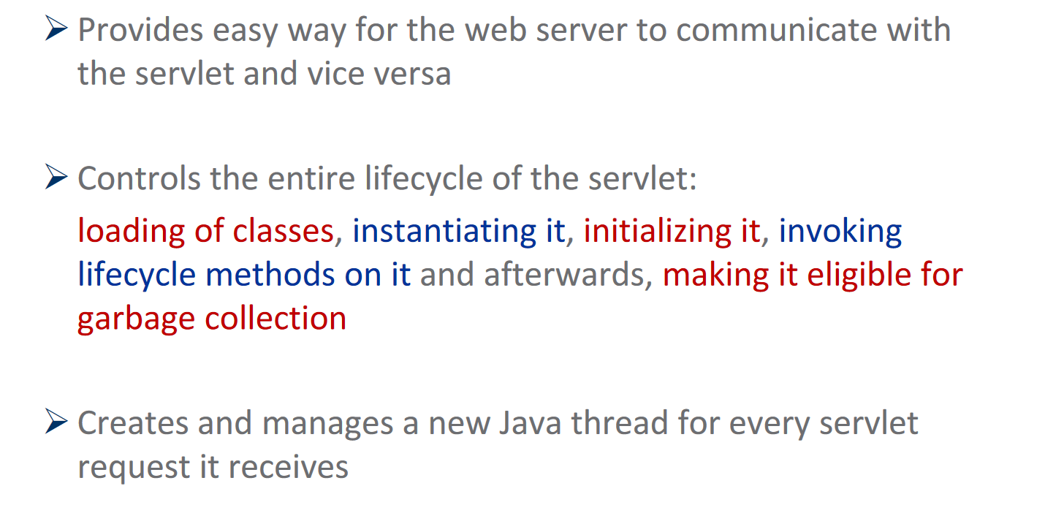
What is the role of Servlet Container?

Slide 50
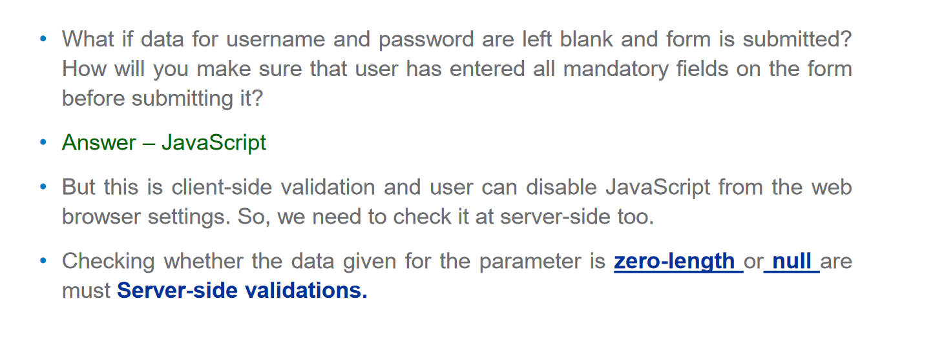
Server-side validations

Slide 51
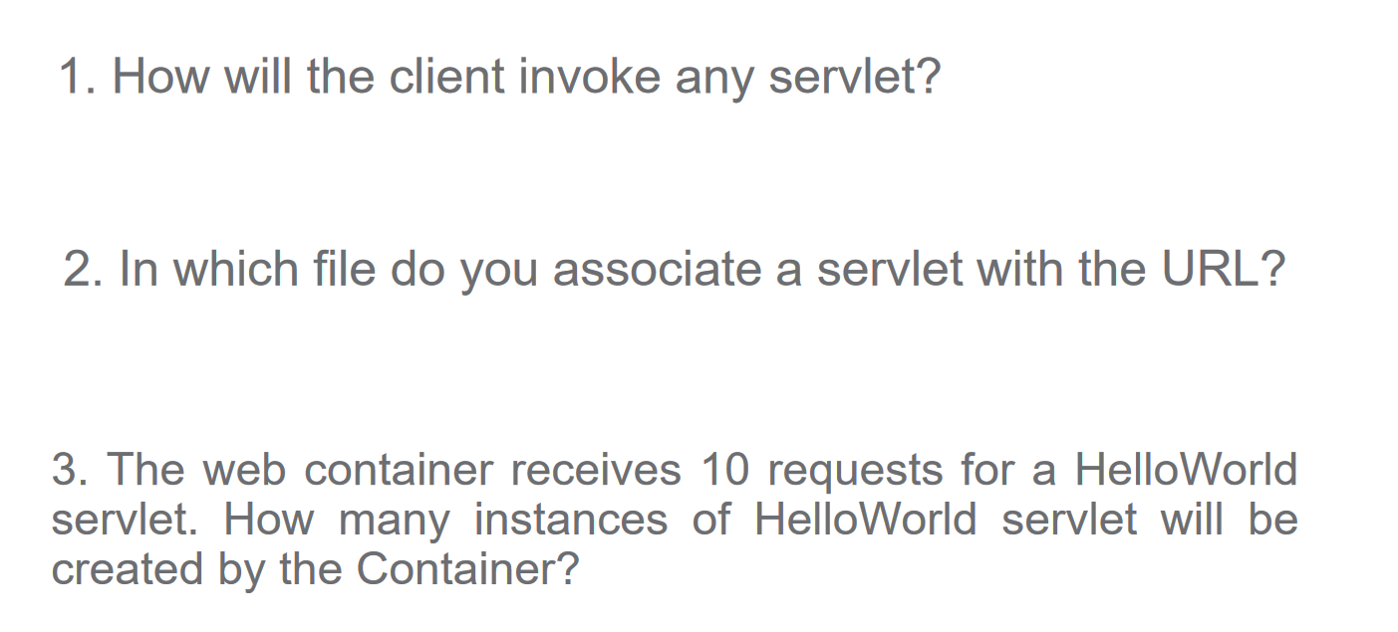
Can you answer these Questions?

Slide 52
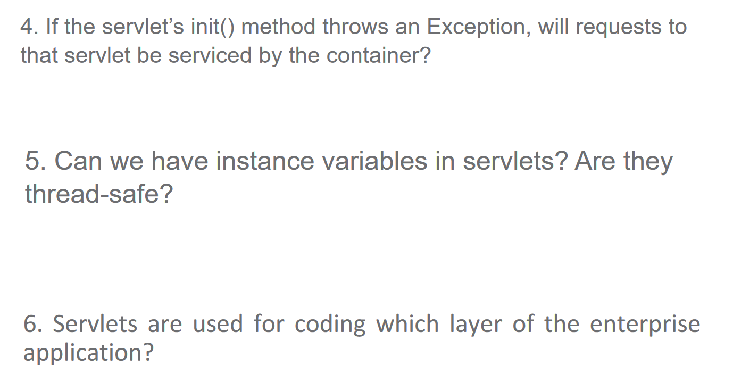

Slide 53
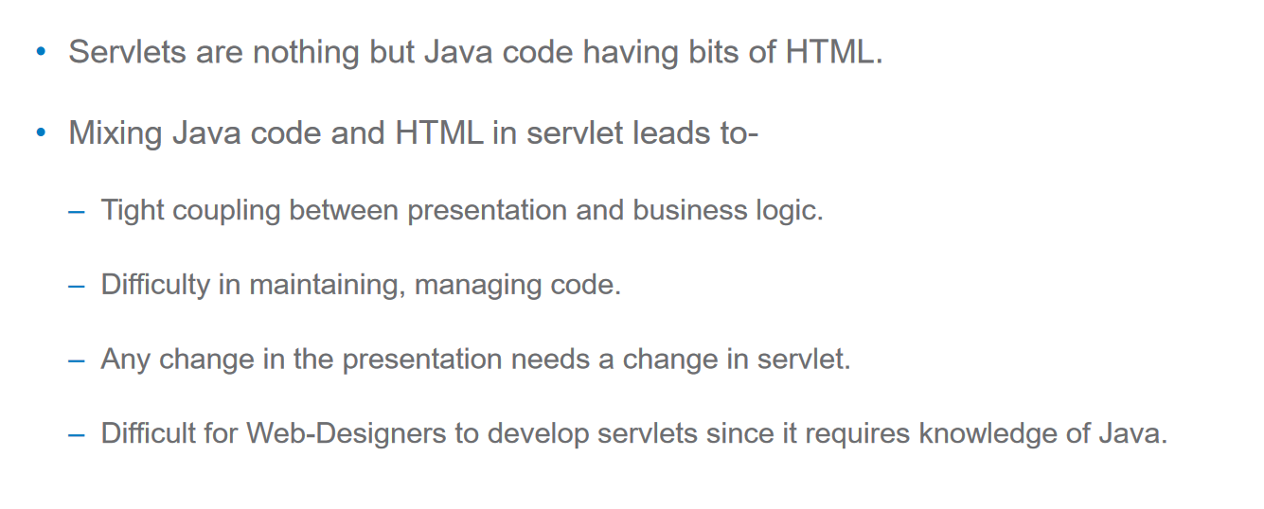
Challenges of using Servlets in web application

Slide 54
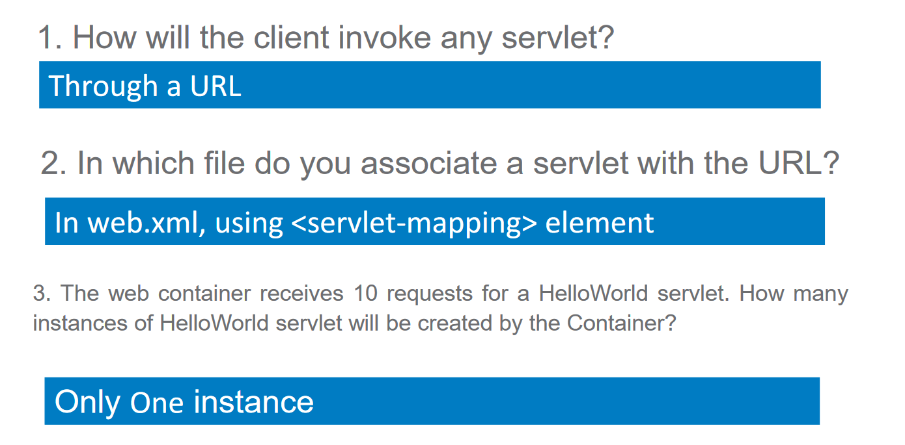
Answers

Slide 55


Slide 56

Challenges of using Servlets in web application

Slide 57

JSP

Slide 58


Slide 59


Slide 60

Servlets Vs JSP

Slide 61

Life Cycle Of JSP

Slide 62

JSP –Life in the Container!

Slide 63

JSP –Life cycle methods

Slide 64

Tags in JSP

Slide 65

Comments in JSP

Slide 66

Scripting Elements

Slide 67

Scripting Elements -Scriptlets

Slide 68


Slide 69

Scripting Elements -Expressions

Slide 70


Slide 71

Scripting Elements -Declaration

Slide 72

Can you Answer these Questions?

Slide 73

Implicit Objects

Slide 74

ImplicitObjects-out

Slide 75

Implicit Objects -request

Slide 76

Implicit Objects -response

Slide 77

Session Tracking

Slide 78


Slide 79

Implicit Objects -session

Slide 80


Slide 81


Slide 82

page Directive –session attribute

Slide 83

Let us revisit implicit Objects

Slide 84

page Directive –contentType attribute

